Slide 1
My personal profile

Slide 2
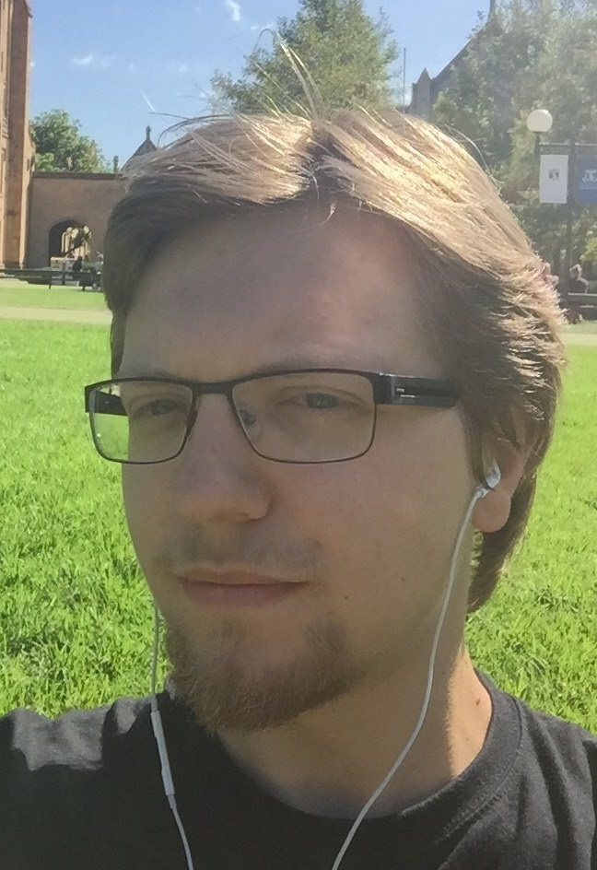






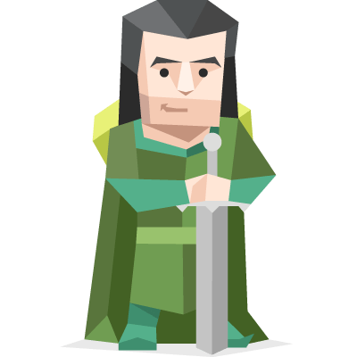
Hello!
My name is Kirill!
Kirill (Valeryevich) Penchukov
High School: Programmer – Lyceum of Information Technology #1533 (Russia)
Undergraduate: Applied Math and Computer Science – MIREA-RTU (Russia)
Postgraduate: Master of IT (Computing) – The University of Melbourne (Australia)
Now:
IT Teacher and Student Mentor at MIREA-RTU (full-time)
Computer Science Engineer at MIREA-RTU (part-time)
ENFJ
– ‘The Protagonist’
Notes:
ENFJ = Extraverted, iNtuitive, Feeling, Judging
Opposite = ISTP = Introverted, Sensing, Thinking, Perceptive

Slide 3
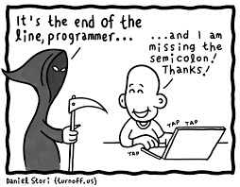
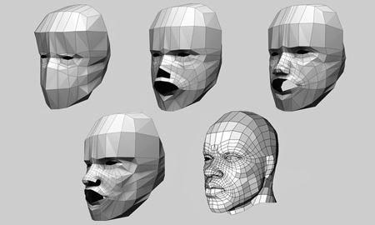
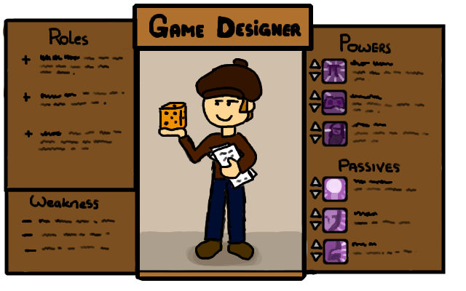

Prerequisites
Desire to Create
Academic Background
Passion for Video Games

Slide 4

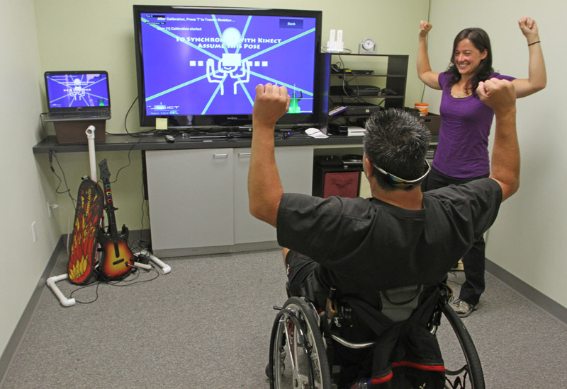
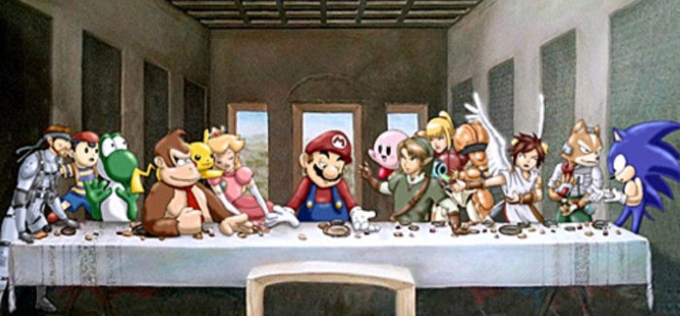
My Global Goals
Gamification: Learning through Playing
Any information can be conveyed
Improving perception through gameplay
Education: direct and indirect
How games affect human development?
Different benefits for different
Make a difference
Games that promote change
Games that help overcome
Games as self-reflection tools
Games as a means of self-awareness
Games as an art for everyone
in different ways
life’s challenges
professions

Slide 5
Why Game Development?
Creativity
Research
Communication
Several professions
in one
Synergy with the
most of my hobbies
Plenty of room for
personal growth
Developing skills
in multiple areas
Love to interact
with people
Can easily find a
common ground

Slide 6




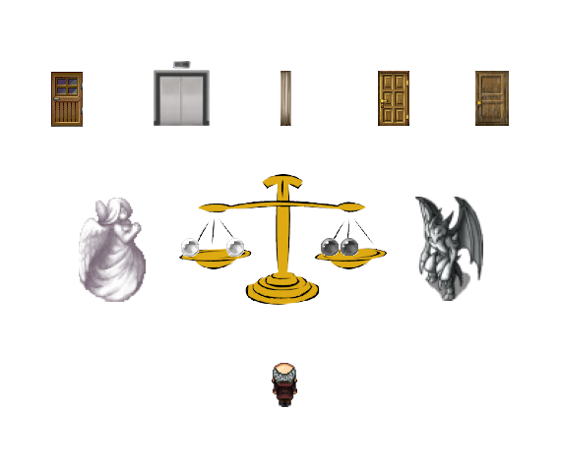
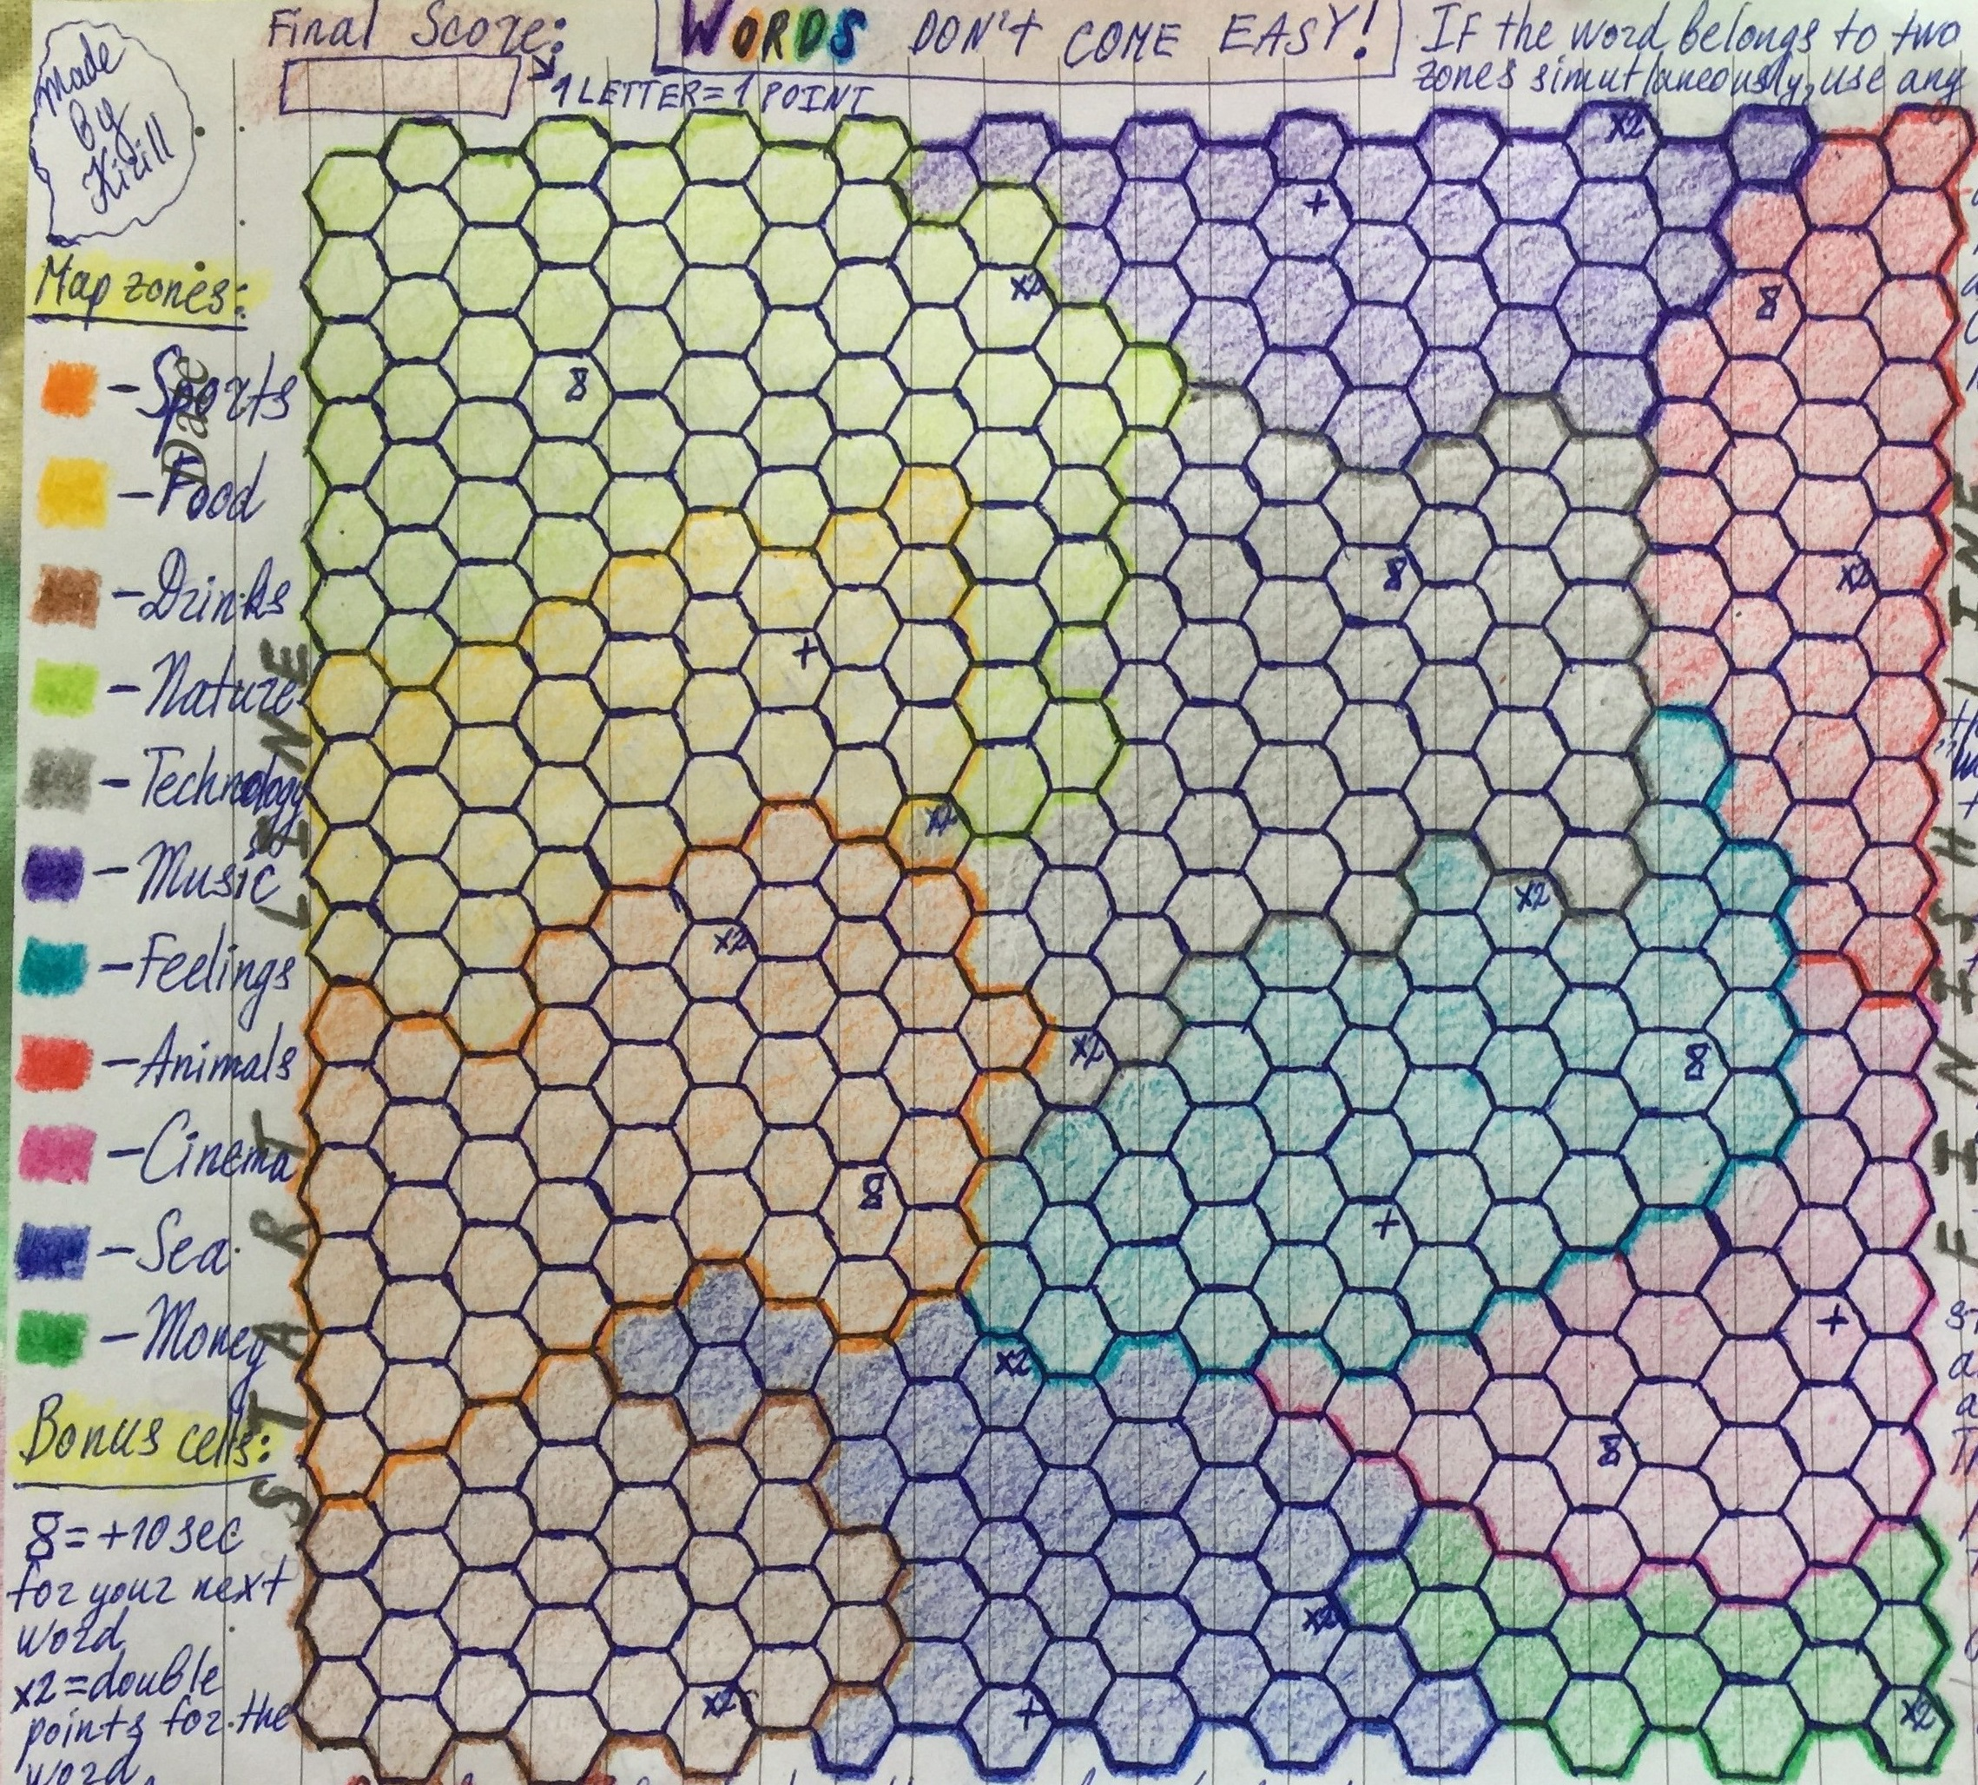
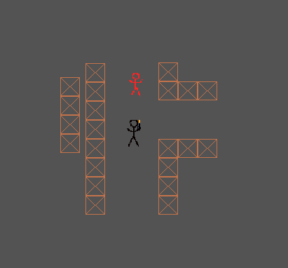
Words Don’t Come Easy!
What Lies Beyond
Word Board game
Get to the opposite side
Different colors =
Grab bonuses to help
Adventure
Determine your afterlife fate
Relive the key
Weigh your sins and
by creating words
moments of life
different topics
yourself win
good deeds
Home in the Dark
Horror
Reach the end while
Darkness around, your
Light sources serve as
Completed
avoiding monsters
visibility is limited
Projects
disposable weapons

Slide 7
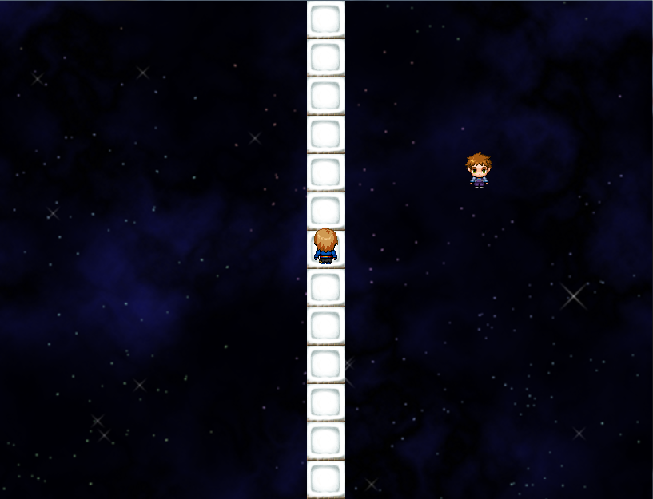

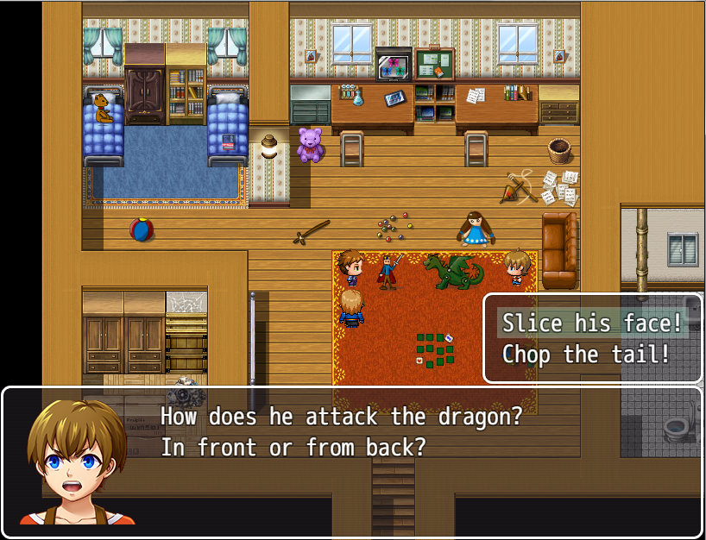

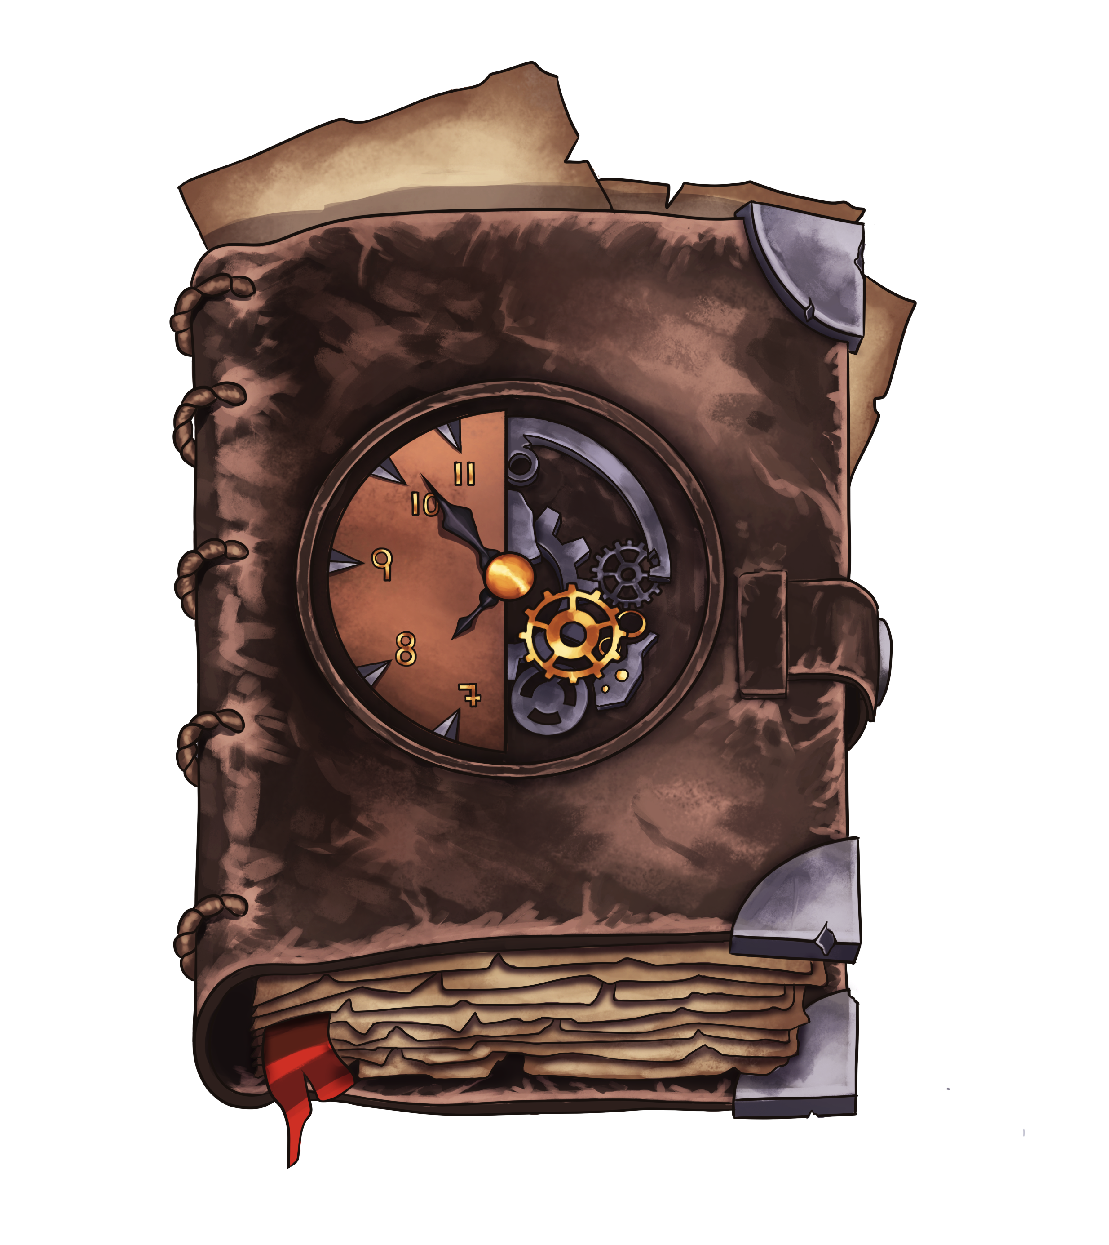

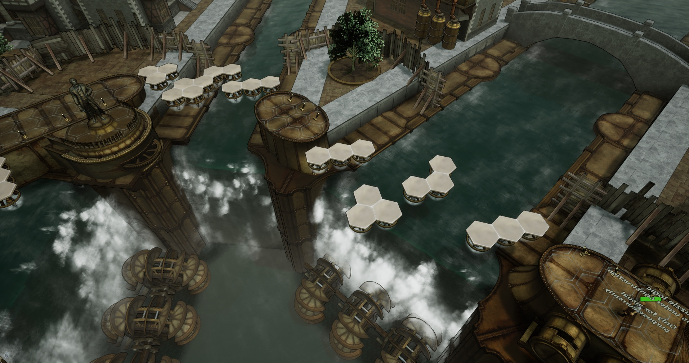
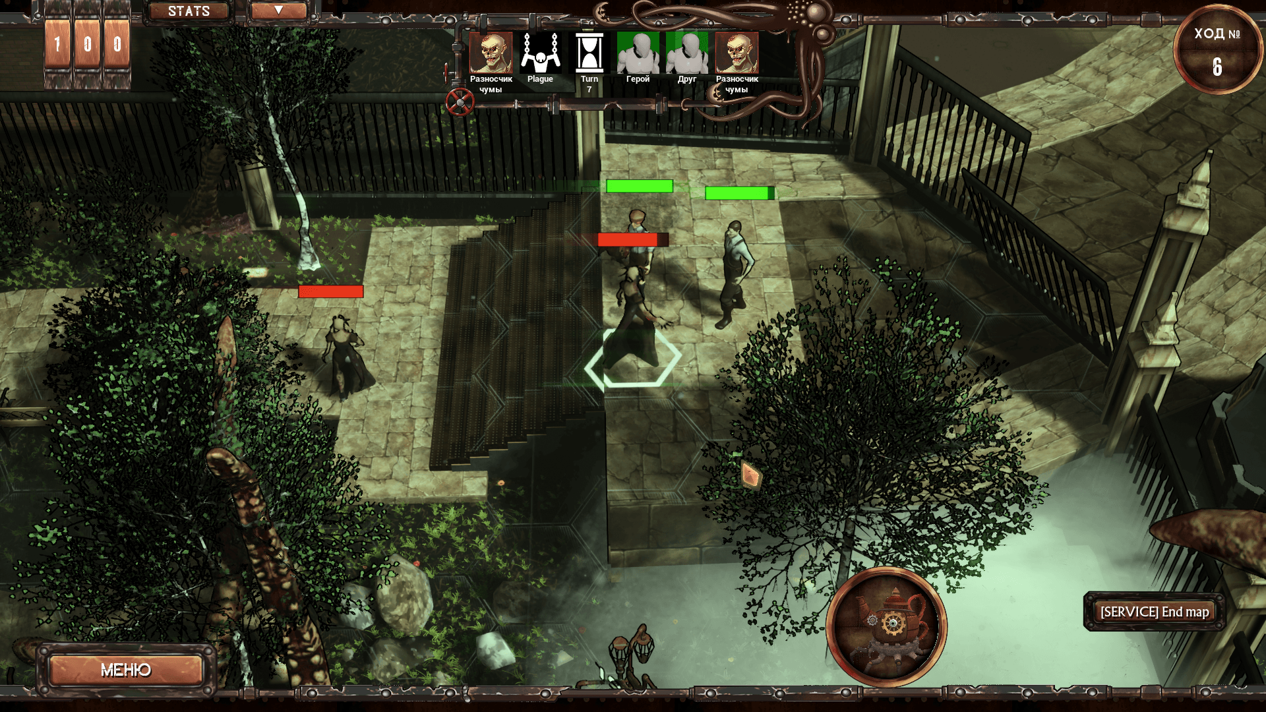
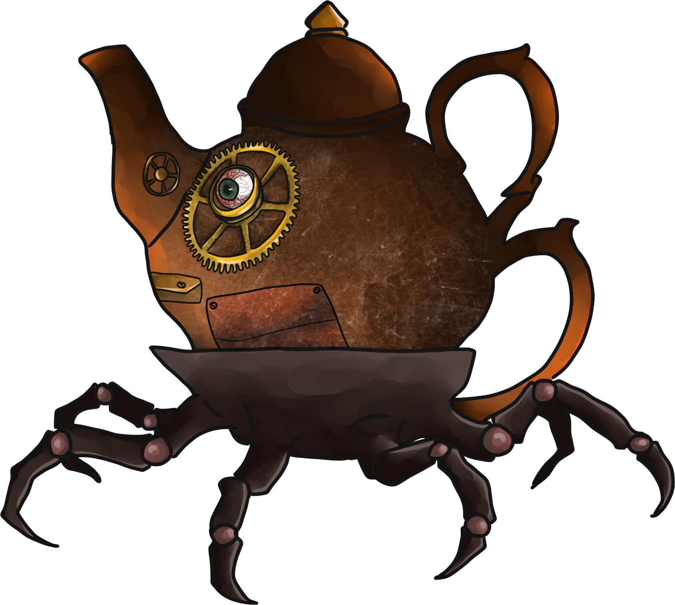

Transience
Current
Adventure
Journey through your past to rebuild the present
Exploration is key: each item contributes
Immersive minigames that let you feel the
Different places, each with its own mood
Solo Project
Projects
to the main story
protagonist
Rubico
Turn-Based Tactics
Fight your way out of the Plague-infested town
Steampunk world built from scratch
Different battles with a variety of allies and monsters
Challenging puzzles for taking a break
Dramatic story accompanied by gloomy music
Programmer and Game Designer
from encounters
in 16-people Project
Notes:
Rubico Links:
Steam Store Page: https://store.steampowered.com/app/1046700/Rubico/
Gameplay Trailer: https://www.youtube.com/watch?v=4zxPq8DxZdw
DEVGAMM Moscow 2019 Game Page: https://games.devgamm.com/moscow2019/games/rubico
Russian Unreal Engine community platform, Game Page: http://ue4daily.com/project/rubico.html
Interview with developers: https://mmoedge.ru/content/interview/2019/07/chuma-na-vash-rubico/
Official Game Page in VK: https://vk.com/rubico_game

Slide 8

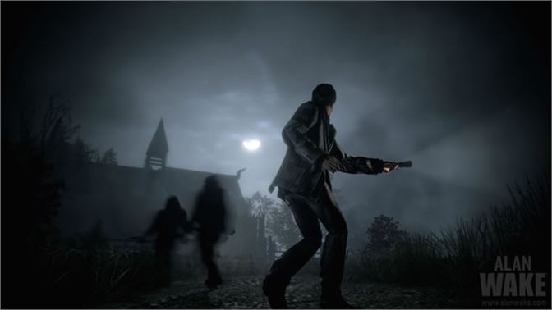
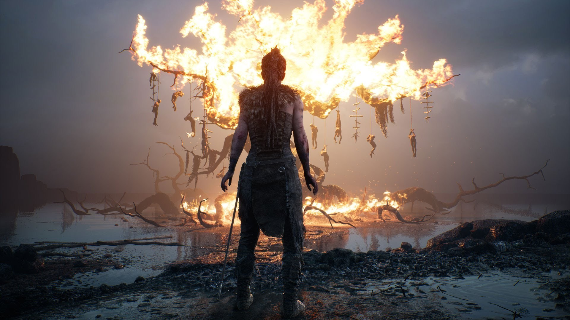

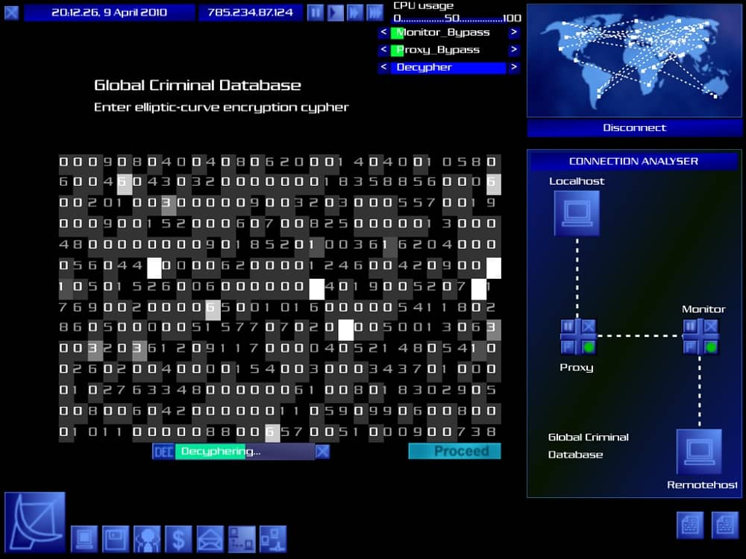

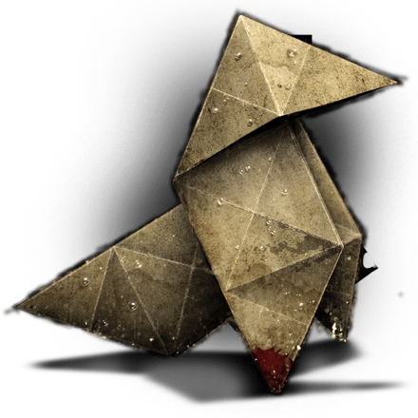

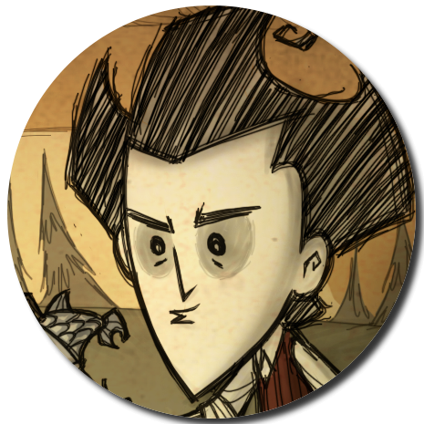


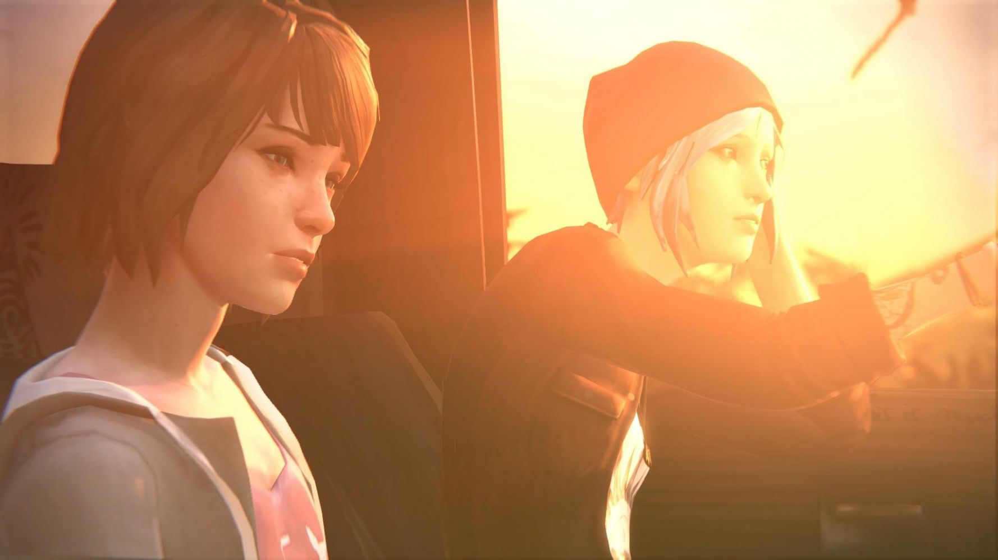

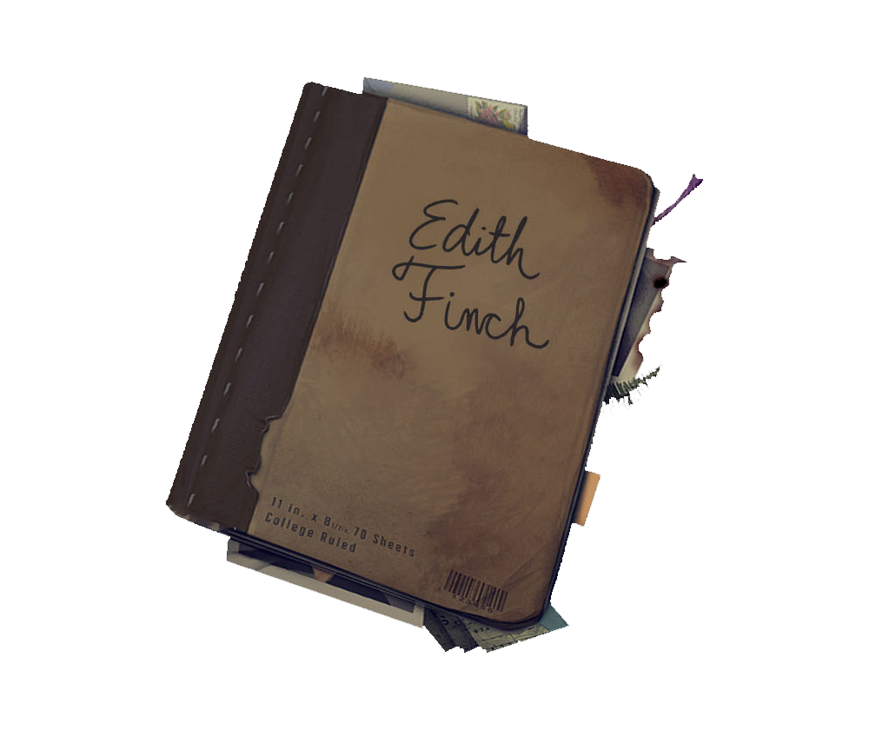
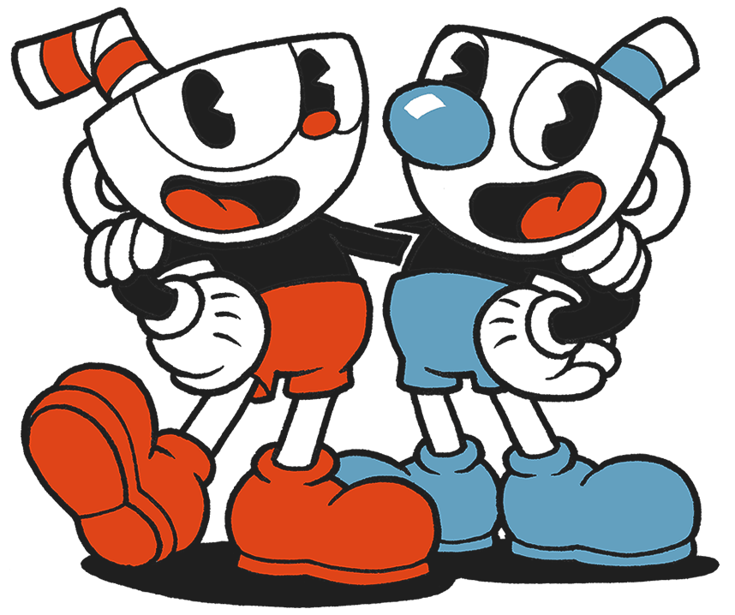

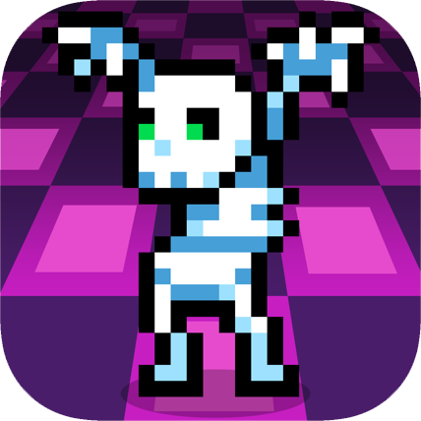
My Inspiration
Most Influential
Recently Played
Alan Wake
Night Springs
Flare Gun
The Clicker
Poets of The Fall
Hellblade: Senua's Sacrifice
Uplink
Trace Tracker
Connection Bouncing
Neuromancer Rating
Music
Honorable Mentions
Diary
Moments of Calm
“This action will have
6 Polaroids
Life is Strange
consequences…”
Notes:
The lists represent my strongest associations with these games.

Slide 9
My Personal Goals

Slide 10

Thanks!

